Slide 1
How Web maps work
An overview

Slide 2
Putting maps on the Web.
We started with ‘the Web’…
We’ll briefly discuss the history of web mapping technology and how we got to where we are today.
Focus on ”tiles” and understanding how they work.
Basic structure of a web map.

Slide 3
Let’s talk web map history
With content from our friends at Mapbox.

Slide 4
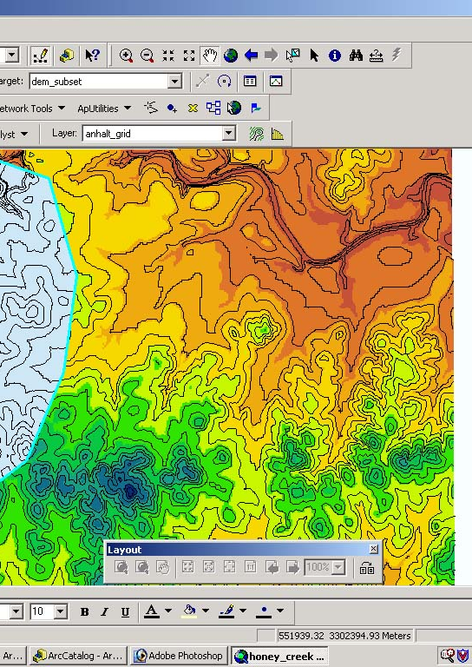
The early days 1990’s
Digital mapping was largely made possible through software packages like ESRI ArcMap (later becoming ArcGIS).
Super useful, incredible technology…
Not user friendly.
GIS for the web around this time was not at all user friendly.
BONUS!
What wrong with this map? >>>>>>>>>>>>>>>>
Spotify Playlist for this lecture!
http://bit.ly/web-mapping-history

Slide 5
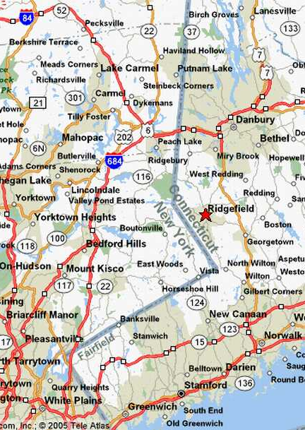
The early days 1990’s
In 1996, Mapquest launched its Web Service.
Directions! Online! Revolutionary!
(but we used to have to print off Mapquest directions)
And it was….
S…
l…
o…..
w….

Slide 6
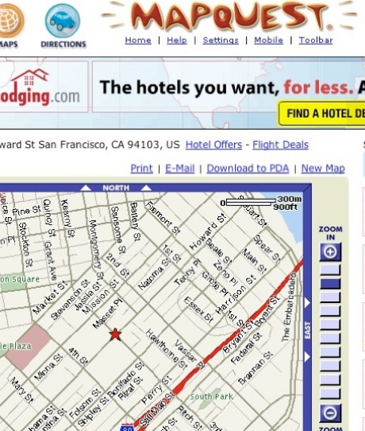
The early days 1990’s
MapQuest required a full-page refresh to scroll or zoom, and was always aligned to tile boundaries.
(see those little “NORTH” and “EAST” buttons?)

Slide 7
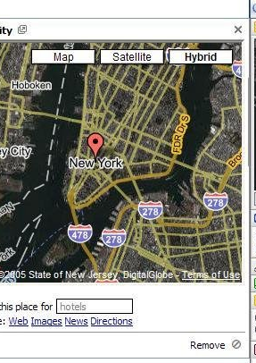
While Mapquest showed the world that maps on the web could be super valuable, Google Maps really paved the way for online mapping, beginning in 2005.

Slide 8
But what was the revolution?
Was it the interface?
The red marker?
The weather widget?

Slide 9
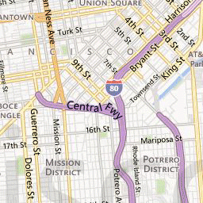
It was the Tile!

Slide 10
All Tiles are the same size!
256x256 pixels
Consistent boundaries!!

Slide 11
Why does this matter?
STANDARDIZATION!!!1
Tiles could be a road map, a satellite image, or anything else that you could put on a map.
And all these little tiles load way faster than one big map.

Slide 12
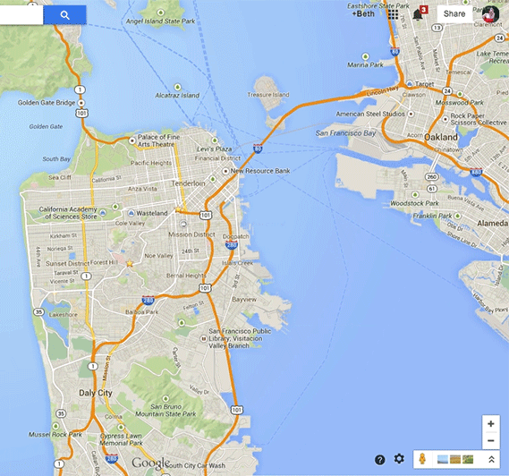
Slippy maps!
Web maps like this only load the tiles that are on your screen. If the map is “smart,” it will pre-load tiles outside of the screen, along the top, bottom, left, and right.
This kind of map is colloquially called a slippy map

Slide 13
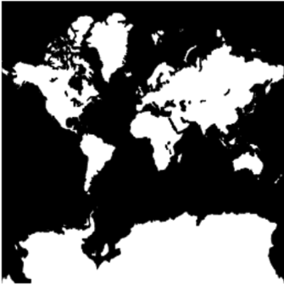
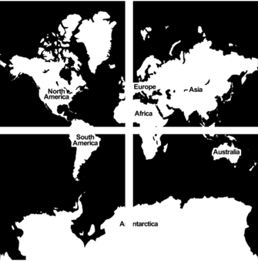
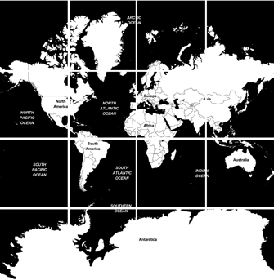
Zoom!
Zoom level 0:
1 tile for the entire world
Slippy maps continued building on the zoom level concept that Mapquest’s popularized a decade earlier.
Each zoom level has its own set of tiles. And each tile in that zoom level has its own “address.”
Each time you zoom in to the map, the number of tiles required to cover a given geographic area is multiplied by four.
Zoom level 1:
4 tiles for the entire world
Zoom level 2:
16 tiles for the entire world

Slide 14
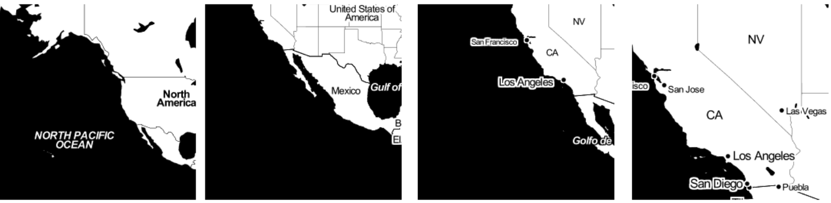
Zoom levels 2, 3, 4, 5...

Slide 15
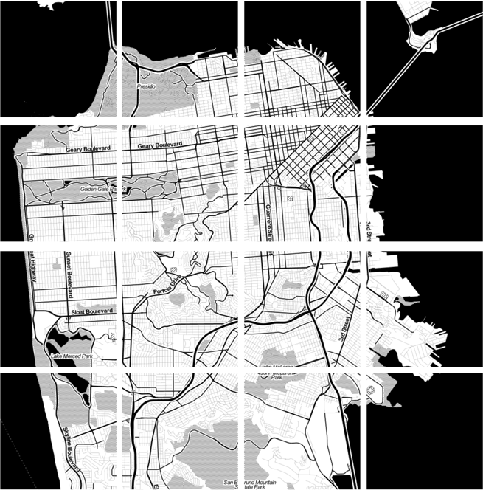
Zoom level 13

Slide 16
Fabulous world of Tiles!
These types of tiles are rendered in advance, then stored in a cache (temporary storage).
Because map tiles are just images on the web, you can link to them individually, just like you would any other image.
This is what allowed us to change the Google static API!

Slide 17
Fabulous world of Tiles! For Example:
http://tile.openstreetmap.org/4/2/6.png
This is the name of the tile server
http://tile.openstreetmap.org/4/2/6.png
This is the z value or “zoom level.”
http://tile.openstreetmap.org/4/2/6.png
This is the x/y value: the place in the grid where the tile lives.

Slide 18
Fabulous world of Tiles! For Example:
You can start looking for these parameters in other places to… Go to http://maps.stamen.com and tile around.
How about Google maps?
https://www.google.com/maps/place/Stockbridge,+MA/@42.3036167,-73.3970104,12z/

Slide 19
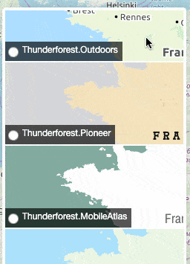
Fabulous world of Tiles! For Example:
The standard language of the tile allowed mapmakers to express their creativity and the map style landscape exploded.
http://leaflet-extras.github.io/leaflet-providers/preview/
Note the min/max zoom levels (you’ll see this in the lab).
Note the {z}/{x}/{y}
Notes:
Show them the leaflet providers preview.
Note the min/max zoom levels (they’ll work on these in the lab).
Note the {z}/{x}/{y}

Slide 20
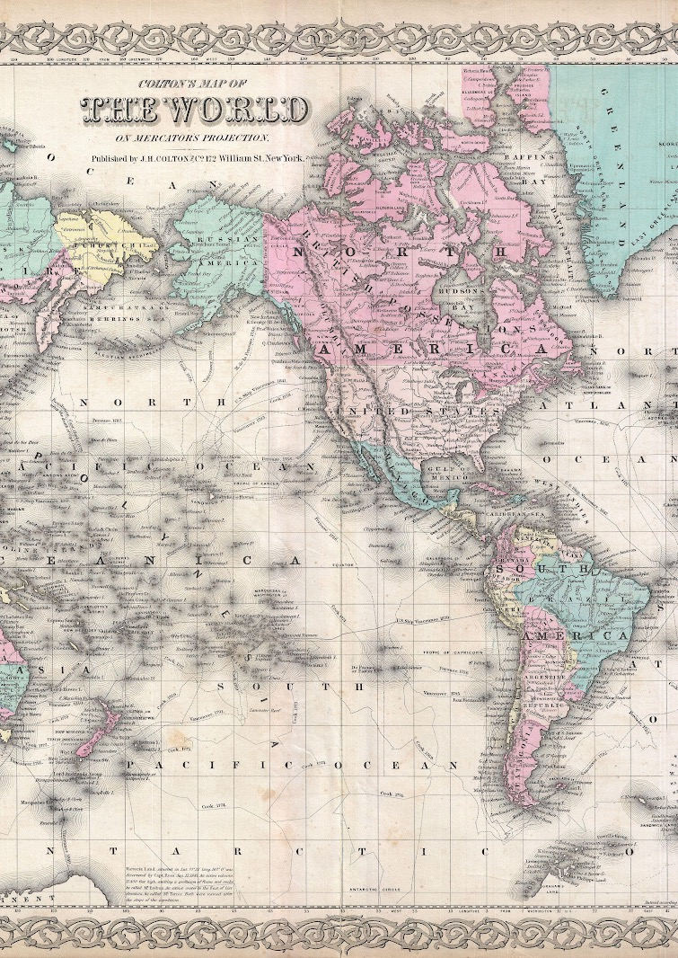
What about that projection?
Notice how all of these tiles are square?
Google maps use a tweaked version of the Mercator projection, which is designed for sailors BUT it works well for flat maps. Why might that be?
The projection Google choose (and everyone copied) is called Spherical Mercator (epsg: 3857).
In order to maintain its coveted squareness, it cuts the world off at 85.06° North and South.
Notes:
Mercator preserves direction! A straight line you draw on the map will be straight in real life. This is great news for a map that needs to be made up of a bunch of lil squares.

Slide 21
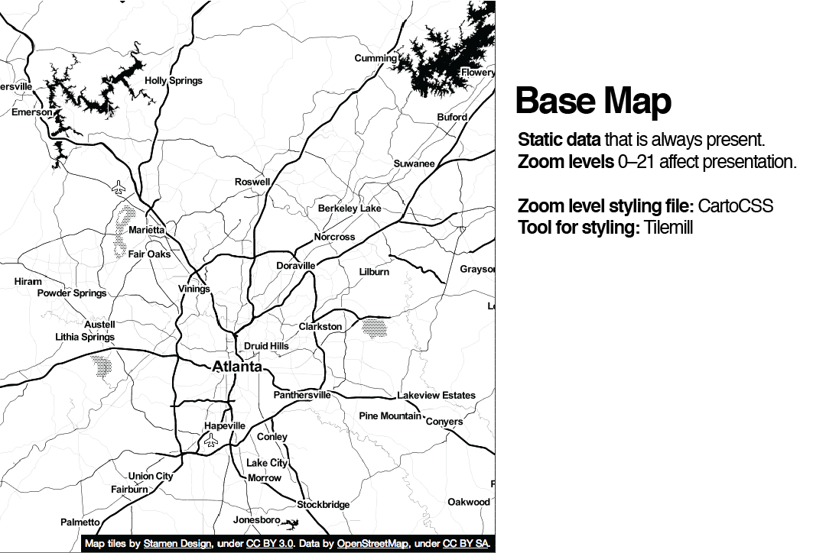
This modern crop of maps shares a common structure:
A base layer made of map tiles with data layers (sometimes referred to as content layers or feature layers) overlayed on top.
This basemap-overlay paradigm was extremely popular among map developers and persists* in many places to this day.

Slide 22
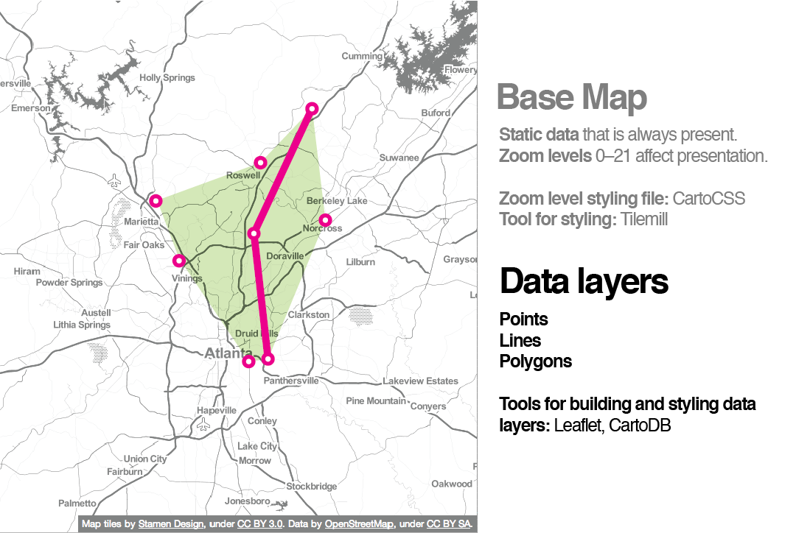
This modern crop of maps shares a common structure:
A base layer made of map tiles with data layers (sometimes referred to as content layers or feature layers) overlayed on top.
This basemap-overlay paradigm was extremely popular among map developers and persists* in many places to this day.

Slide 23
But how should you work?
You’ll need to set up your preferred coding environment.
You’ll also need to learn to work with a team.
There is not right/wrong way to do these things… what follows are tried and true practices that I like.

Slide 24
Setting up your Development Environment
When building stuff for the web you really need:
A code editor, which can prompt you with tags/code, help you see your code easily, help you debug, etc.
A way to preview things (generally before you publish them to the web).
A workflow.

Slide 25
Setting up your Development Environment
A lot of what we are doing in this class is building things for the web, using online, hosted, services. But there are going to be times when you want to work offline, or check things quickly to experiment with new ideas.

Slide 26
Setting up your Development Environment
Some code editors allow you to preview what things will look like (when you are coding in HTML, for example).
You can also create a “local host” – have your computer act like a server.
Sometimes, for some things, you can drag/drop files into a browser, but not always.
Notes:
https://www.mamp.info Looks like a good, free, local server option.

Slide 27
Shadrock prefers…
Atom (good, lightweight code editor developed by the folks at Github). You can get it for free: https://atom.io
There’s a plug-in to create a live local host: https://atom.io/packages/atom-live-server.
Github desktop for working locally: https://desktop.github.com/

Slide 28
Priyanka prefers…
WebStorm (Developed by JetBrains).
Free with educational license: https://www.jetbrains.com/shop/eform/students
Supports version control through Git
In-built simple webserver for local hosting
Provides auto completion
Supports testing on multiple web browsers
Tracks changes through Local History and provides ability to roll back changes anytime

Slide 29
The labs have…
Microsoft Visual Studio Code (good code editor).
Works with Github.
You can get it for free: https://code.visualstudio.com/?wt.mc_id=DX_841432
Third-party extensions will give you a preview (this can’t be installed in lab but you can do it on your local machine).
Some preview capability in Microsoft Edge Browser.

Slide 30
Tools & workflows for team
Slack, Skype, other instant messaging platform:
Why? Searchable, archived discussions that are easier to sort through than emails. Separate ”channels” for different topics.
Google Docs, Word docs in OneDrive, Dropbox Paper:
Why? Because nobody wants 47 email attachements with different people’s edits and different names… version control is a nightmare this way.
Kanban boards! (I like Trello - https://trello.com - but there are others)
Why? Be sure everyone is working from the same “to-do” list and that everyone can see how things move along from “to-do” to “let’s celebrate: it’s finished!”
https://kanbanize.com/kanban-resources/kanban-software/ for deeper dive on what Kanban is and how to use it as a method.

Slide 31
Typical workflows for team
Slack, Skype, other instant messaging platform:
Discussions: decide who does what, what needs to get done, etc.
Ask questions, clarifications, exchange weird memes.
Kanban boards
Document and track to-do lists. Have a brief, weekly meeting to do through the boards and keep them updated. This does not happen on it’s own! Always designate owners for tasks.
Google Docs, Word docs in OneDrive, Dropbox Paper:
Draft text here: good place to start documentation, reports, narrative text. Good place to put photos, images, etc. Allow everybody to edit, make comments, etc.
Github:
The ultimate container. Use the “issues” tab to get specific about “to-dos” on your Kanban board.
Use branches to copy the code base, modify it, then update.

Slide 32
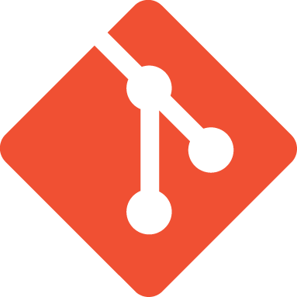
Version control?
It is Git:
That is, it is built on Git, an open source version control system that is very popular in software development.
You know how Google Docs lets you edit in real-time and track changes in Microsoft Word both try to prevent the horrible circle of document versions (my-report-draft2-final-final-final-reallyreallyfinal-thistimeforreal.docx), but they are still not really perfect?
Version control systems like Git are another way of approaching the same problem. Except its main strategy for doing so consists of:
1) forcing you to take very explicit steps to make changes to your document/code and
2) keeping an extremely detailed log of the changes made along the way.

Slide 33
Version control!
It is Git, continued:
🤔 BUT WHY
Who did what and when did they do it?
Each time you save changes (or "commit" changes, in the language of Git), those changes are associated with a completely unique ID that you can reference later if you want to do things like:
Go back in time to an older version without destroying your current version.
Reference a specific set of changes when communicating with a collaborator.
Figure out when a bug or feature was first introduced.
Notes:
This level of specificity allows software developers to figure out who made which changes and when they did it. Each time you save changes (or "commit" changes, in the language of Git), those changes are associated with a completely unique ID that you can reference later if you want to do things like:

Slide 34
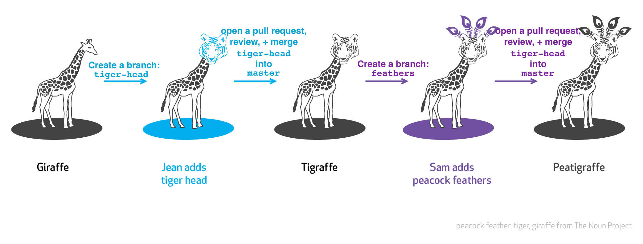
Branching!
It is Git, continued:
🤔 BUT WHY
Make a copy of the codebase, modify it, and then ask the original codebase’s owner to incorporate your changes.

Slide 35
It is Hub:
Collaboration and community.
Issue tracking
Often used for bug reports and feature requests, but can also be used as a little mini document for planning changes, getting feedback on the project's direction, etc. Folks can comment and have a whole convo. Neat!
Pull requests.
Often called PRs. Special kinds of issues for asking a collaborator or project maintainer to review some proposed code changes and, if they like them, pull those changes into the main codebase.
Website hosting
Wikis
Thus hubby nature is nicely suited to a classroom setting. We'll be doing all kinds of collaborating, referencing code, and communicating.
Today, we're going to dip our toes into GitHub and help build your foundation for the rest of the class.
Over the next couple of slides, you'll:
Fork the class repo. This means you'll make a brand new copy of the class repo in your own GitHub account.
Open a pull request to personalize your new forked repo.
Notes:
The "hub" part of GitHub refers to its collaboration and community aspect. Every collection of code and documents (called a "repository" or "repo" in the language of GitHub) also comes with features for opening Issues, Pull Requests, giving people permission to collaborate, etc!

Slide 36

Fork!
In GitHubland, a fork is an exact copy of a repo that you create in your own account.
Why?
Experiment!
Splinter off and go your own direction.
Permissions
If you think your changes are really spiffy, you can open a pull request and ask the maintainer of the main project to incorporate your changes.
Notes:
Maybe you want to experiment without messing up the code in the main version of the repository. Maybe you don't like the direction the project is going and want to split up! Maybe you just don't have sufficient permission to make edits.

Slide 37
Forking gotchas?
You betcha.
The copy you make is not synchronized with the main project.
It's a snapshot made at the time you click the fork button. If you want, you can catch up to the main version of the project using a series of Git commands, but this will not happen automatically.
Notes:
Maybe you want to experiment without messing up the code in the main version of the repository. Maybe you don't like the direction the project is going and want to split up! Maybe you just don't have sufficient permission to make edits.

Slide 38
So what did we cover today? Any questions?
The major underlying technology of most web maps is map tiles!
All these different tile sets allow us to get and create new base maps upon which to put our data layers!
You’ll need to set up your preferred environment for coding (although a lot of what we’re doing is in-browser and hosted environments).
You’ll need to meet with your team and establish workflows, tools you want to use, etc.
Get ready for STUDIO!!!!!
I will post HTML, CSS, and JS tutorials for you to work on over Spring Break: not required by highly recommended if you want to take things farther.
Notes:
Whether you are new to web development or just need to dust off some old skills, here are some helpful resources to get you started:
https://www.codecademy.com/learn/learn-html
https://www.w3schools.com/html/
https://www.udacity.com/course/intro-to-html-and-css--ud001
https://www.khanacademy.org/computing/computer-programming/html-css
https://www.codecademy.com/learn/learn-css
https://www.w3schools.com/css/default.asp
https://www.codecademy.com/learn/introduction-to-javascript
https://www.w3schools.com/js/default.asp
https://www.khanacademy.org/computing/computer-programming/programming#concept-intro

